Slide 1



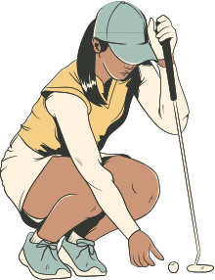
HOW HAS NEW TECHNOLOGY CHANGED THE GAME OF GOLF?
BY: COLTON VANOVERBERGHE

Slide 2


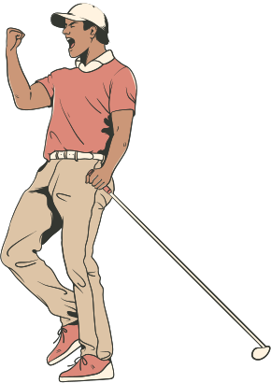
BACKGROUND
The game of golf itself hasn’t changed since its creation. However the equipment used in today’s age is far more advanced than the beginning
The data I collected does not go as far back to the creation of the game. As many of these statistics weren’t recorded. Through multiple different points of comparison I have deciphered if new technology has impacted the game of golf.

Slide 3



RESEARCH QUESTIONS
  Has new technology impacted the average score on the PGA Tour
  How have individual performance stats progressed over time?
  How does statistical placement relate to Wins/ World Ranking?

Slide 4


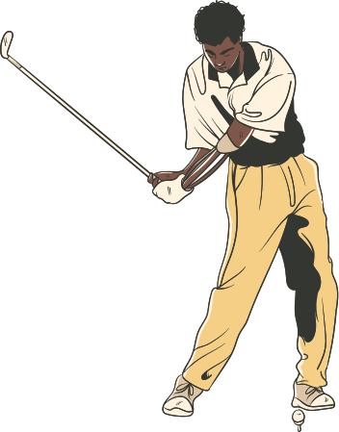
THE DATA
  Source: PGATour.com
  Years: 1993-2023
VARIABLES OF ANALYSIS
    Scoring Average
    Birdie Average & Total
    Driving Distance & Accuracy
    Greens in Regulation
    Average Putts & Low Putt

Slide 5



DRIVING DISTANCE
  Average Driving Distance
    Steady increase for best & worst on tour
    The spread between best and worst avg on tour fluctuates
  % of Drives 320YDs+
    The % fluctuates greatly for Best on the Tour
    2018 was the first year in which every player recored a drive 320yds+

Slide 6

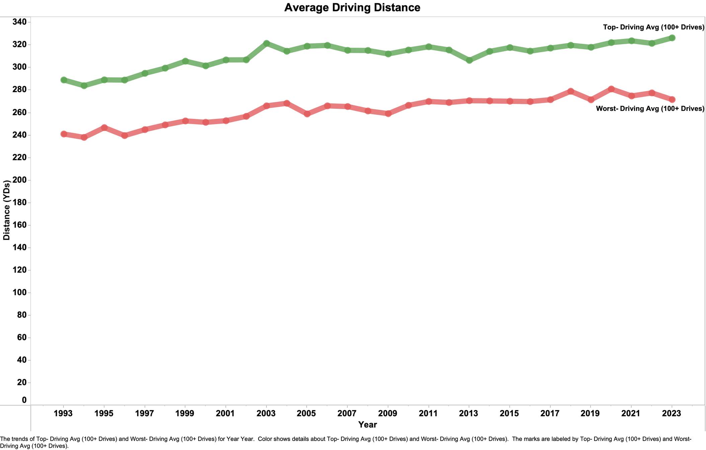

Slide 7
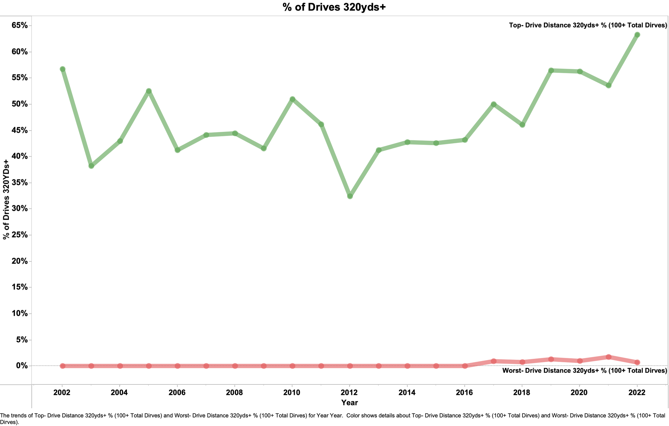

Slide 8
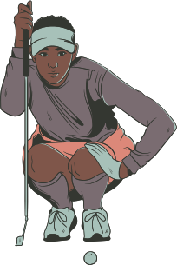
BIRDIES AND MORE
  Double Eagle: 3 Under Par
  Eagle: 2 Under Par
  Birdie: 1 Under Par
  Par: Expected Score
  Bogey: 1 Over Par
  Double Bogey: 2 Over Par
  Etc.

Slide 9
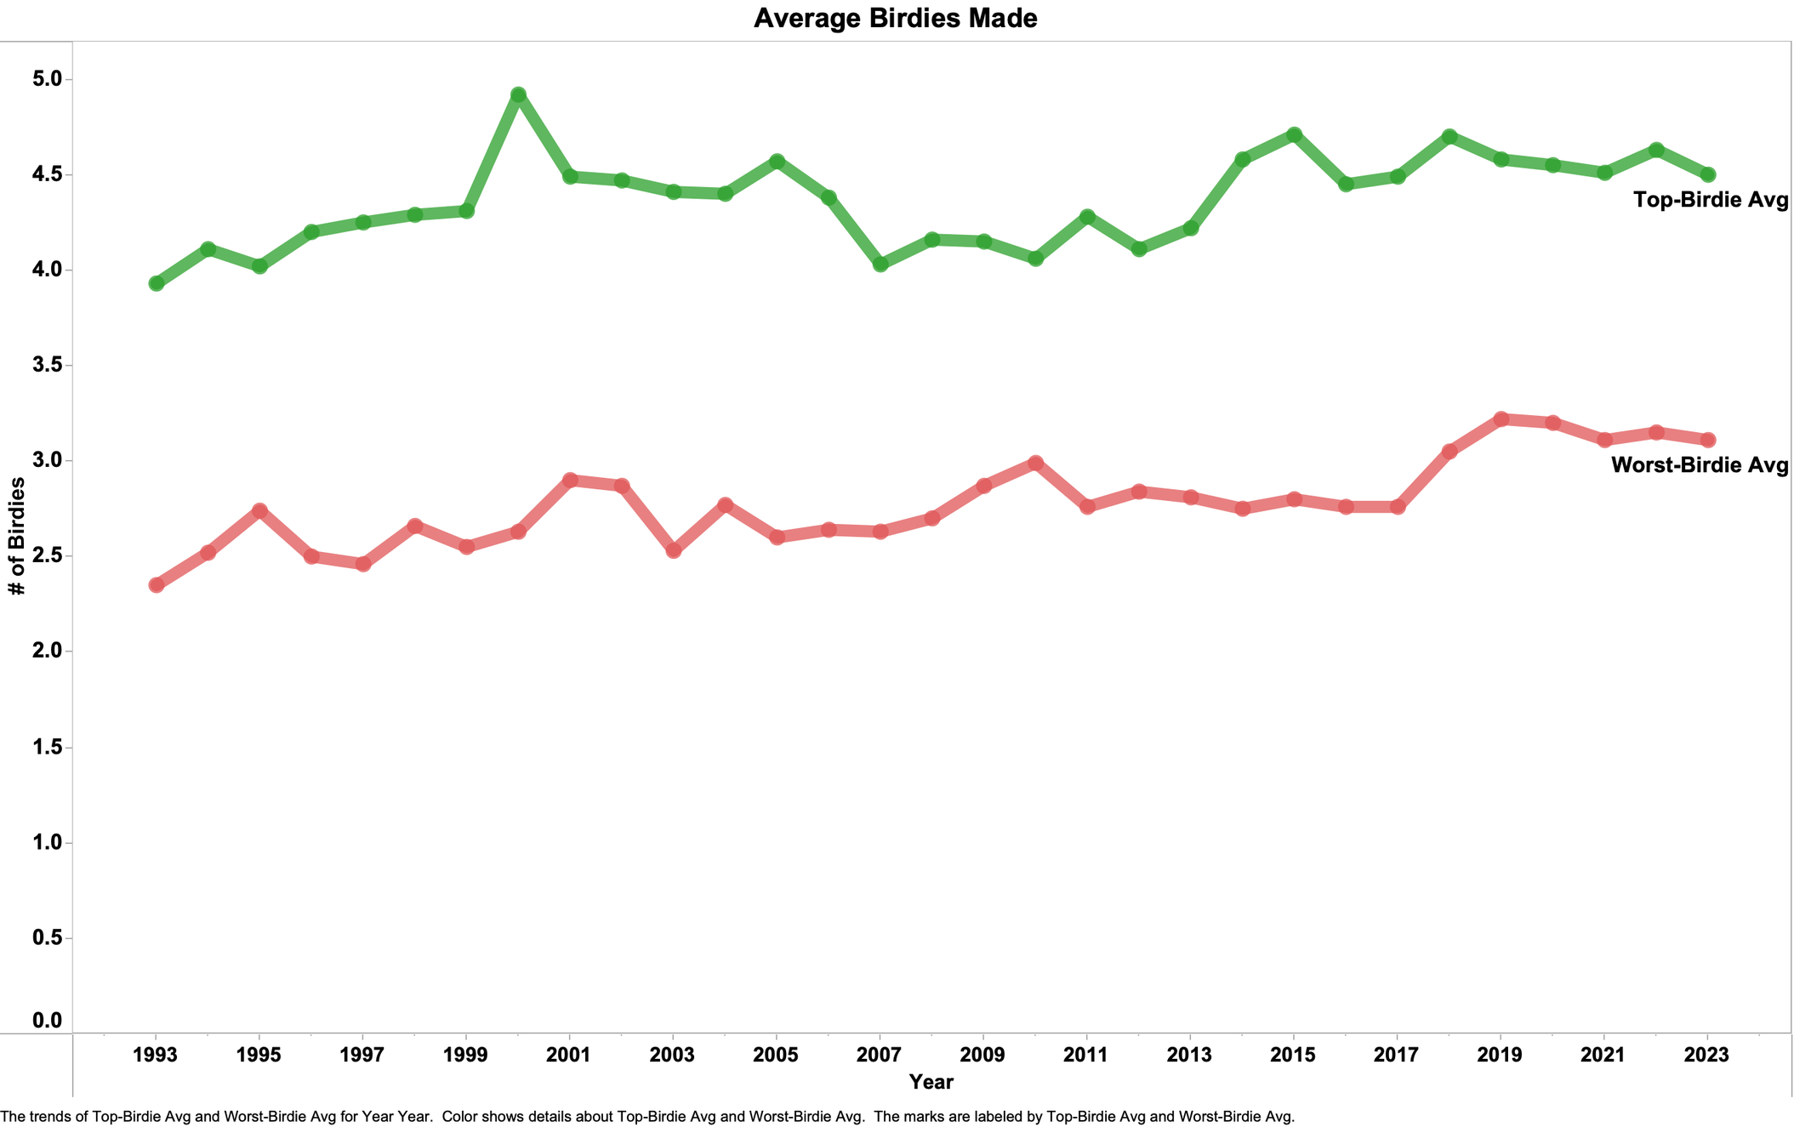

Slide 10
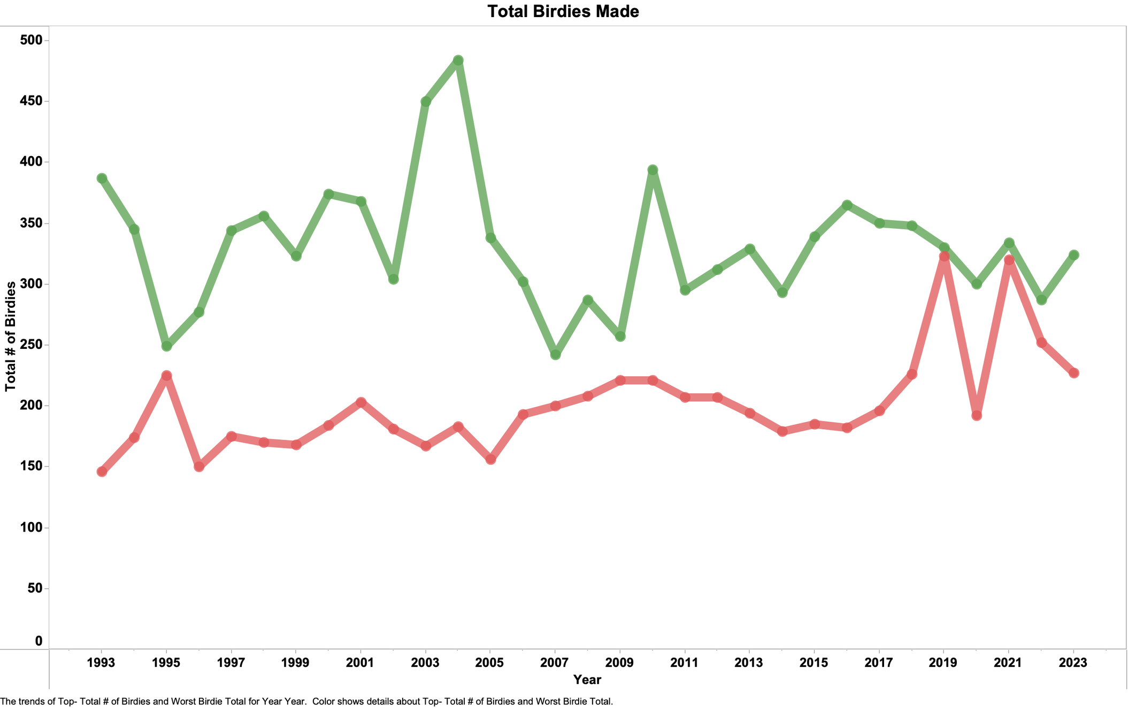

Slide 11
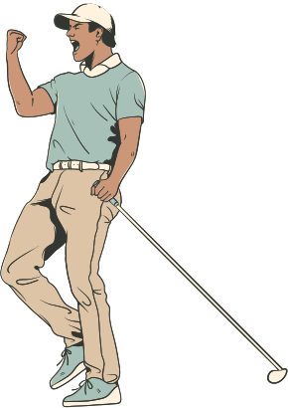

GREENS IN REGULATION
  “Green in Regulation” refers to a golfer getting their ball on the “Green” in two stoke fewer than Par
  This gives the golfer a great chance of obtaining Par on the hole or better a Birdie

Slide 12
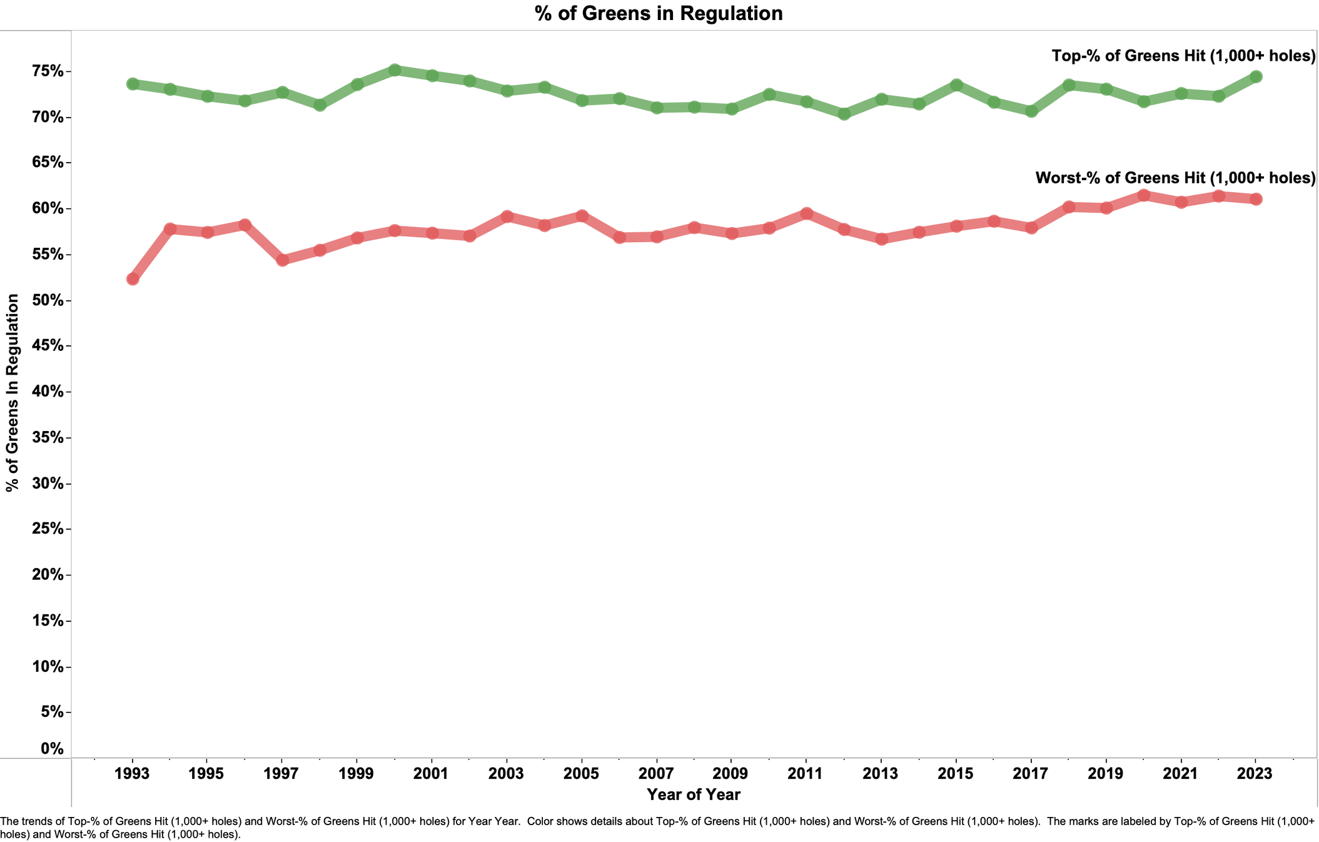

Slide 13

PUTTING
  Putting is vital to achieving better golf scores. By eliminating even a few putts, you can expect to save three or four strokes every round.
  Putting is the apex of each hole on a course. Everything that you’ve done on the hole has led you to the point where your putt/putts will complete the hole successfully…or not.

Slide 14
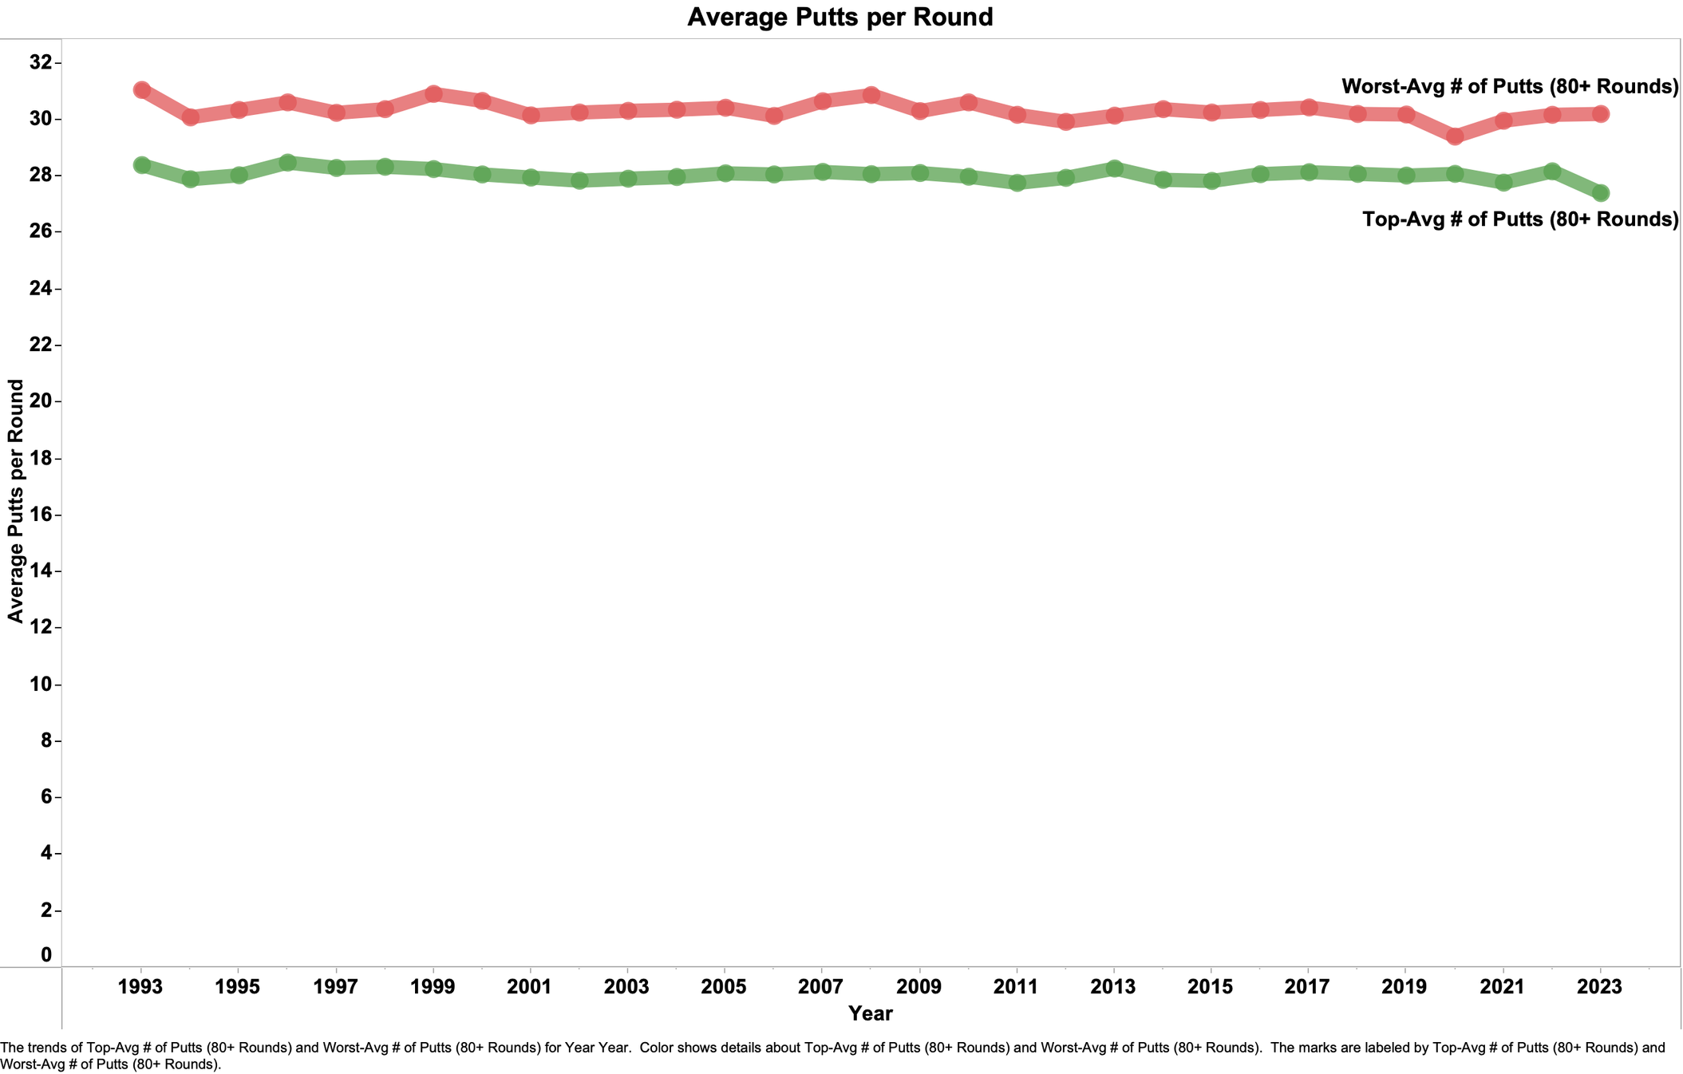

Slide 15
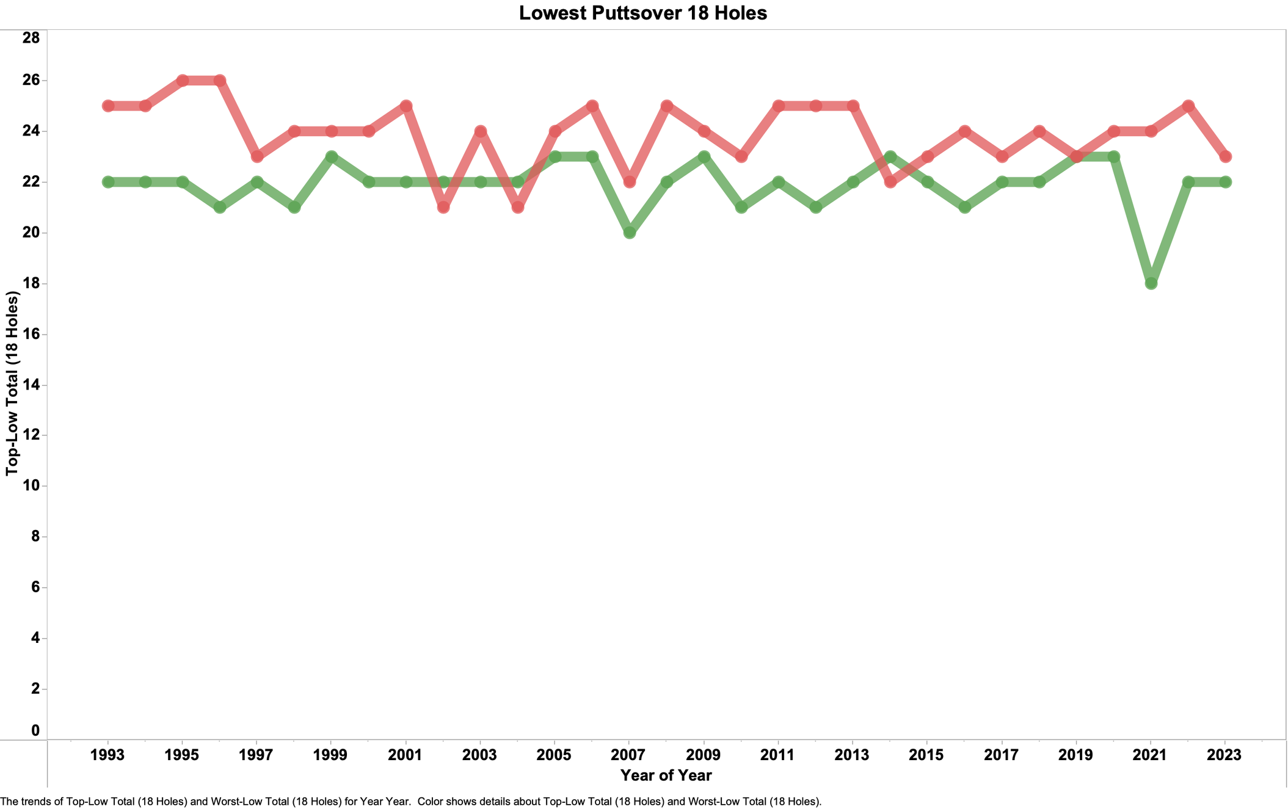
Worst- Lowest Putts over 18 Holes
Top- Lowest Putts over 18 Holes

Slide 16

STATICAL PREFORMANCE
VS AVERAGE SCORE
  My objetive was to determine if there was a specific statistical category that correlated with top overall preformance

Slide 17
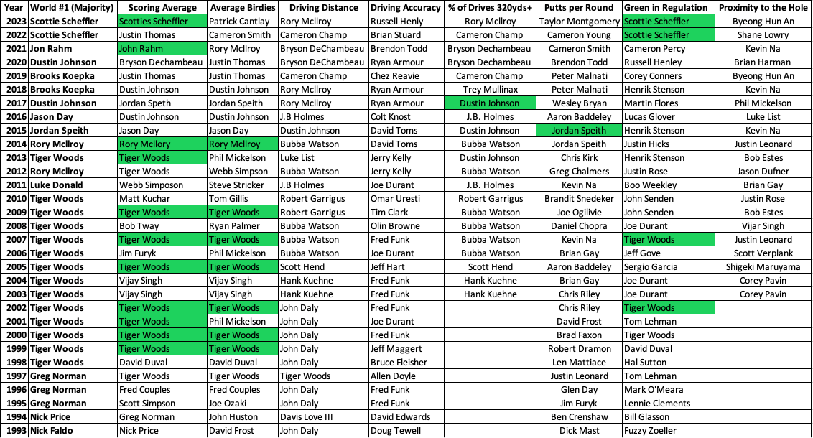

Slide 18


RESEARCH QUESTION ANSWERS
  Overall advancement in the technology used in Golf clubs has had a steady effect on decreasing the Average PGA Score
  There was a much greater difference Year-to-Year in the individual statistics compared to overall score
  There does not appear to be a direct correlation between Top Performer in a certain statictic and average score

Slide 19




Thank You

